Slide 1
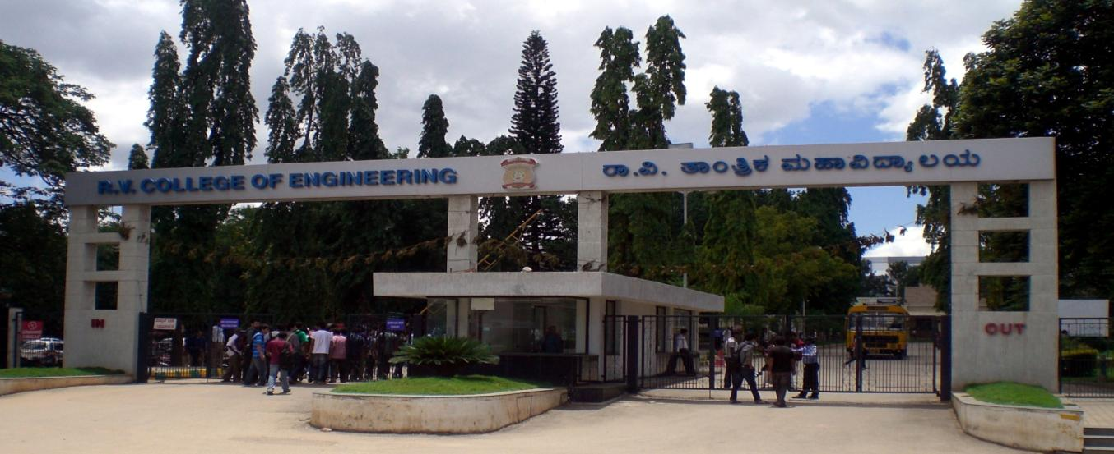
VIII Semester Major Project Work (12CS81)
Department of Computer Science,
R V College of Engineering, Bengaluru.

Slide 2
CCTV Video Summarization in Urban Environments
A.S. Karthik 1RV15CS001
Abhishek Krishna 1RV15CS007
Gagan Deep G 1RV15CS053
Internal Guide : Dr Ramakanth Kumar P (Professor and HoD CSE)

Slide 3
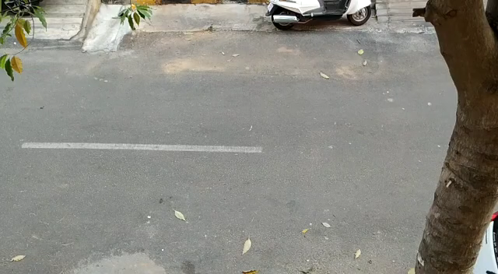
Input

Slide 4
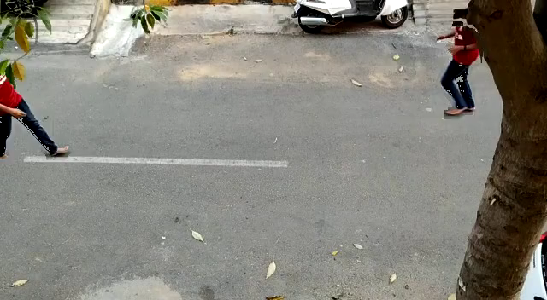
Output

Slide 5
Literature Review
Year, Name of the Journal/Conference | Title of the paper | Authors of the paper | Model/Sub Model used | Challenges of the paper | Limitations of the paper
AAAI Conference on Artificial Intelligence. 2018. | Deep Reinforcement Learning for Unsupervised Video Summarization | Zhou, Kaiyang, Yu Qiao, and Tao Xiang. | LSTM | End to end summarization of movies | Computationally expensive, Not suitable for CCTV video footage
Computer Vision and Pattern Recognition, 2006 | Making a Long Video Short: Dynamic Video Synopsis | Rav-Acha, Alex, Yael Pritch, and Shmuel Peleg. | Motion detection-based synopsis | Methodology for rearrangement of video clips in time | Not based on any queries other than time
ICCV 2007. IEEE 11th International Conference on. IEEE, 2007. | Webcam Synopsis: Peeking Around the World | Pritch, Yael, et al. | 2 phase approach to summarization | Object queue to deal with limited storage space | No smart querying based on objects

Slide 6
Literature Review
Year, Name of the Journal/Conference | Title of the paper | Authors of the paper | Model/Sub Model used | Challenges of the paper | Limitations of the paper
IEEE Transactions on Pattern Analysis & Machine Intelligence 11 (2008) | Non-Chronological Video Synopsis and Indexing | Pritch, Yael, Alex Rav-Acha, and Shmuel Peleg. | Storage of original video frames along with extracted tubes | Method for indexing the summary video to link back to the original video | No smart querying based on objects
Computer Vision and Pattern Recognition (CVPR), 2016 IEEE | You Only Look Once, Unified Real-time object Detection | Joseph Redman, Santhosh Divvala, Ross Girshick, Ali Farhadi | YOLO 24 layered CNN | Real-time object detection and localisation | Lesser accuracy compared to other standard models.
ELSEVIER Pattern Recognition Letters, 2014 | Efficient adaptive density estimation per image pixel for the task of background subtraction | Zoran Zivkovic, Ferdinand van der Heijden | MOG2 | Pixel by pixel dynamic selection of number of Guassians | Susceptibility to noise, computationally expensive.

Slide 7
Literature Review
Year, Name of the Journal/Conference | Title of the paper | Authors of the paper | Model/Sub Model used | Challenges of the paper | Limitations of the paper
Computer Vision and Pattern Recognition (CVPR), 2010 IEEE | CRAM: Compact Representation of Action in Movies | Mikel Rodriguez | Clifford Fourier Transform | Can detect specific actions | Doesn’t keep all events in the final summary
Advanced Video and Signal Based Surveillance. IEEE, 2009. | Clustered synopsis of Surveillance Video | Pritch, Yael, et al. | Similarity based clustering | Determining the extent of similarity between different events. | Unable to clearly differentiate between events having high similarity.
IEEE, 2003. | A Shortest Path Representation for Video Summarization | Porter, Sarah V., Majid Mirmehdi, and Barry T. Thomas. | Graph cuts | Creates panoramic summaries | It is static, produces images

Slide 8
Research gap
There is no method to generate summaries based on the properties of the objects in the video (Smart synopsis based on tags)
Lack of clear optimization techniques for rearrangement of spatio-temporal object tubes.

Slide 9
Objectives Revisited
Development of a video-summarization system
Experiment with different techniques (simulated annealing, genetic algorithms) to re-arrange the events in time for creating an optimal summary
Develop a method to generate the summary based on user queries with tags (smart synopsis)
Develop a GUI for viewing the generated summary
Host the project as a service in the cloud

Slide 10
Methodology
We perform the video summarization in 2 phases.
Phase 1 – Real-time phase
This phase takes place when the camera footage is being recorded.
The footage is processed and stored so that it can be accessed easily and be used for the 2nd phase
Phase 2 – Query phase
The summary is generated based on a user query
The data stored in phase 1 is retrieved and used for generating the final summary

Slide 11
Methodology – Phase 1
Background Masking
Object Tubes computation and extraction
Motion Detection
Object Detection and tagging
Footage and metadata storage

Slide 12
Methodology – Phase 2
Tube Rearrangement
Blending tubes and background to create summary
Selection of tubes based on user query
Time-lapse background generation

Slide 13
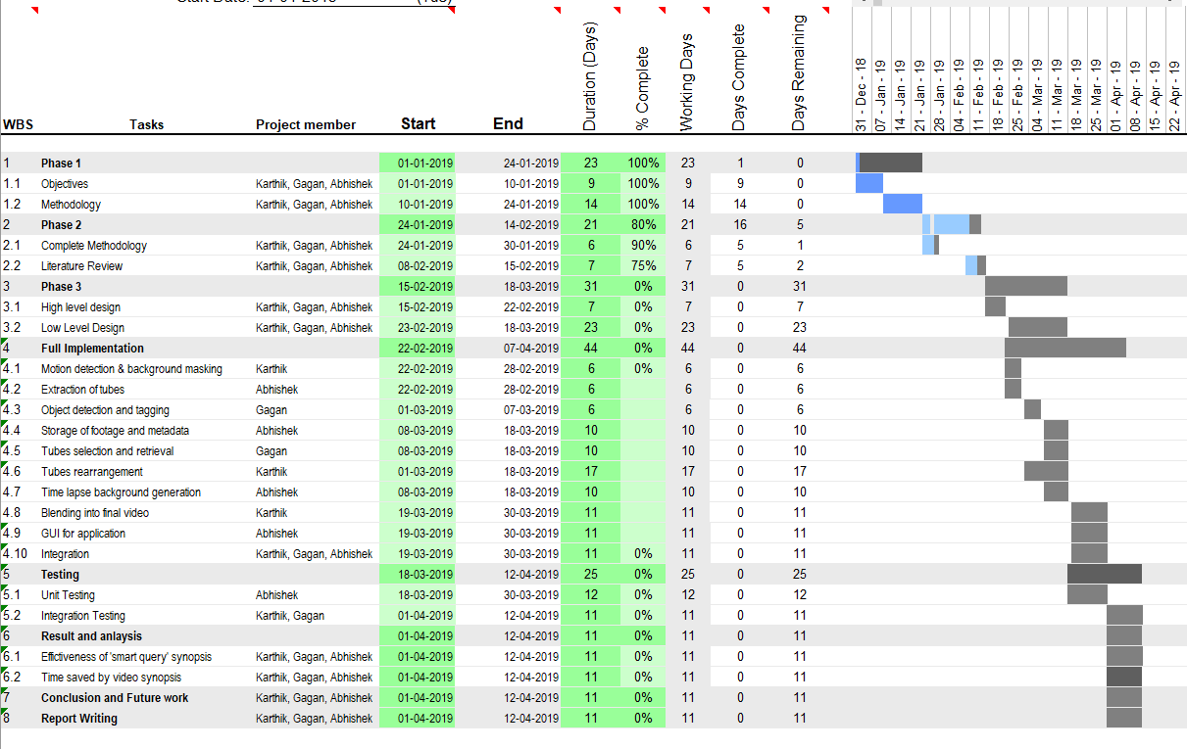
Planning of Project work and Team Structure

Slide 14
Thank You

Slide 15
References
Author, ‘Title of the journal paper’, Publication ,Vol, Issue, page number, Year of publication.
Example. Honig, M.L., Steiglitz, K., and Gopinath, B. ‘Multichannel signal processing for data communication in the presence of crosstalk’, IEEE Trans. Communications., 38, (4), pp. 551–558, April 1990,
Author(s) First name or initials. Surname, ‘Title of Conference paper,’ presented at the Name of the Conference, City /State, Year , page number.
Example. A. H. Cookson and B. O. Pedersen, ‘Thermal measurements in a 1200kV compressed gas insulated transmission line’,in Seventh IEEE Power Engineering Society Transmission and Distribution Conference and Exposition, 1979, pp. 163-167.
3. Author(s) First name or initials. Surname, ‘Title of Technical report’, Abbrev. Name of Co. or Inst., City of Co., Abbrev. State, Technical Report number, Year of Publication.
Example. T. Kasami, ‘An efficient recognition and syntax analysis algorithm for context-free languages,’ Air Force Cambridge Res. Lab., Bedford, MA, Sci. Rep. AFCRL-65-558, 1965.
4. Author(s) First name or initials. Surname, ‘Title of patent,’ U.S. Patent [Patent authority] x xxx xxx [patent number], Month, day, year.
Example. T. Mei and T. Yang, ‘Circuit and method for average –current regulation of light-emitting diodes,’U.S. Patent 7 898 187 B1, 2011, Mar. 1, 2012.
5. Author(s) First name or initials. Surname, ‘Title of Book’ , Edition number ,Publication , Year.
Example. C. W. Lander, ‘Power Electronics’, 3rd. ed., London: McGraw-Hill, 1993.

